Slide 1
AdaBoost Algorithms
Detailed presentation

Slide 2
What is AdaBoost (Adaptive Boosting) Algorithms
Week Model 1
Predictions on Data 1
Data 1
Update weights
Data 2
Week Model 2
Predictions on Data 2
Final Model
Predictive Model 2 result
Update weights
Predictive Model 3 result
Data n
Week Model n
Prediction on Data n
Week Model 1,2,..n are individual models (mostly decision tree stumps which has max_depth=1)

Slide 3
Detailed Steps
Steps:
Initially assign same weights to each record in the dataset.
Sample weight = 1/N
Where N = Number of records
Get random samples and replace the original data with the probabilities equal to the sample weights
Fit the model to the random samples and predict the classes for the original data. Here model is Decision stumps which has one node and two leaves
Calculate Total Error
Total error is nothing but the sum of weights of misclassified record.
Total Error = Weights of wrongly predicted records i.e sum(wrongly predicted data * sample weights)
Total error will be always between 0 and 1.
0 represents perfect stump (correct classification)
1 represents weak stump (misclassification)

Slide 4
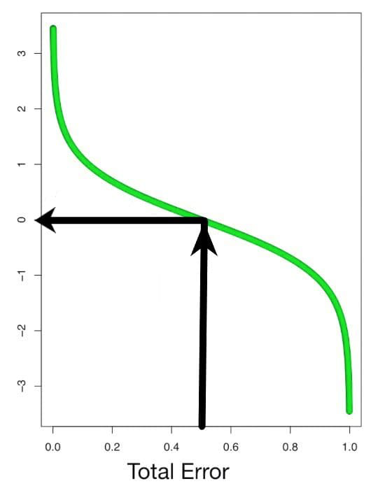
Detailed Steps
Steps:
4. Calculate Performance of the Stump
Performance of the stump(α) = ½ log (1 – Total error/Total error)
If the total error is 0.5, then the performance of the stump will be zero.
If the total error is 0 or 1, then the performance will become infinity
or -infinity respectively.
If the performance high , then stump did the good job and if the performance is low, then stump didn't do good job. Using performance stump(α), we can increase the weights of the wrongly classified records and decrease the weights of the correctly classified records.

Slide 5
Detailed Steps
Steps:
5. Update weights
Based on the performance of the stump(α) update the weights
New weight = Weight * e^{(performance)} → wrongly predicted records
New weight = Weight * e^{-(performance)} → correctly predicted records
Wrongly predicted: e^(performance)
When the performance is relatively large, the last stump did good job and new sample weight is high as compared to old stumps.
When the performance is relatively low, the last stump did not do good job and new sample weight is little bit higher as compared to old stumps

Slide 6
Detailed Steps
Steps:
5. Update weights
e. Correctly predicted:e^-(performance)
When the performance is relatively large, the last stump did good job and new sample weight is small as compared to old stumps.
When the performance is relatively low, the last stump did not do good job and new sample weight is little bit smaller as compared to old stumps

Slide 7
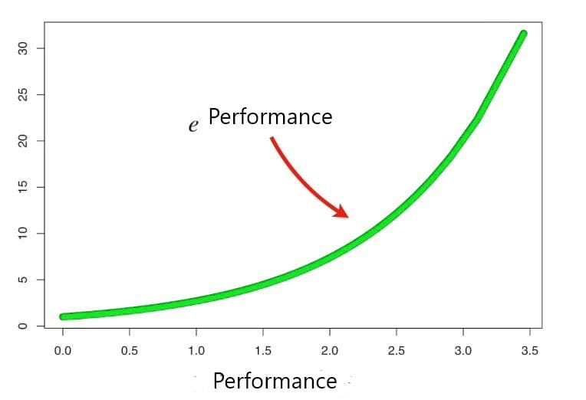
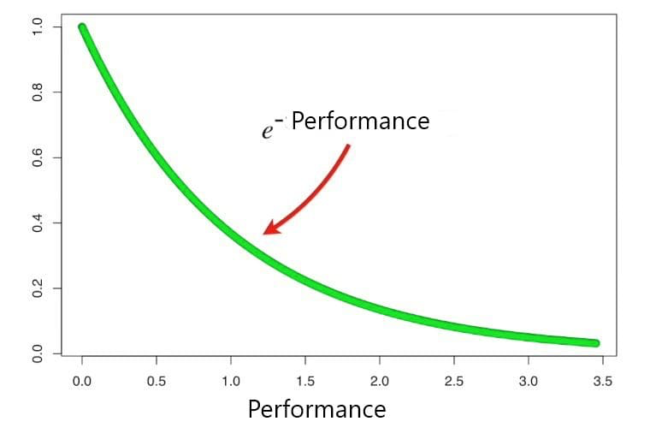
Detailed Steps
Performance of wrong prediction Performance of right prediction

Slide 8
Detailed Steps
Steps:
6. Normalize weight
The initial sum sample weights is equal to 1 so the updated weight should not be zero so we need to divide the weight with sum of updated weights
Normalize weight = weight/sum(weight)
7. Update weights in iteration
Go to the second stump and update the weight so that wrongly predicted records have high weights and will get higher probability of getting selected
8. Repeat the steps 2 to 5 until we reach the 100% accuracy or the n_estimators are exhausted
9. Final prediction
Final prediction = ∑ (α_{i}* (predicted value at each iteration)). Here α_{i} is performance values of stump

